Slide 1
Plugins

Slide 2
Outline
Goals
Phases
Compiler plugin
Jar plugin
Sources plugin
Javadoc plugin
Effective POM
Multi-module Project

Slide 3
Default Goals
clean, compile, test, package, install, deploy
Goals
Super pom has goals defined
inherently added to the effective pom

Slide 4
<plugin>
<artifactId>maven-clean-plugin</artifactId>
<version>3.1.0</version>
<executions>
<execution>
<id>clean</id>
<phase>clean</phase>
<goals>
<goal>clean</goal>
</goals>
</execution>
</executions>
</plugin>

Slide 5
validate
Validate project and structure
compile
Compile any source in the project Test
Test the compiled code package
Packages the code in the specified package type
Phases

Slide 6
integration-test
Deploy and run integration tests
verify
Run checks to verify integrity install
Install package in local repo deploy
Copy package to remote repo
Phases

Slide 7
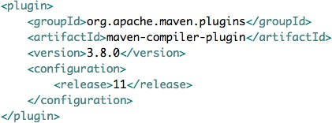
Compiler Plugin
Invokes javac
Defaults older Configuration
fork Memory
source/target

Slide 8

Jar Plugin
Package
Package phase Configuration
includes/excludes Manifest

Slide 9

Source Plugin
Package source code
Package phase Overridden to later phase

Slide 10

Javadoc Plugin
Package javadocs
Package phase Overridden to later phase
Defaults
Many customization options

Slide 11

Effective POM
A complete POM combining the project's pom.xml, inherited, and default configurations.
Contains executable content, including execution steps, properties, and profiles.
Includes an exhaustive set of dependencies (with transitive ones) and plugins.
Resolves potential dependency conflicts.
Ready for direct execution by Maven.

Slide 12
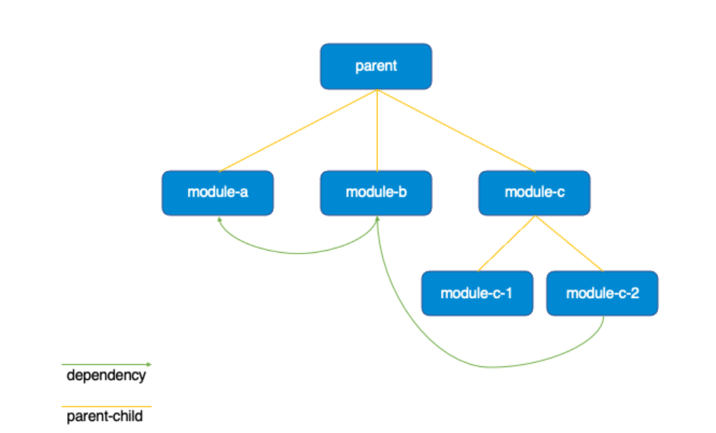
Multi-module project
Centralized Management
Shared Configuration
Modular Development

Slide 13

Goals
Plugins
Summary
Compiler plugin
Jar plugin
Source and Javadocs
Effective POM
Multi-module project

